Slide 1
Competition Law Seminar Series: merger control
Tuesday 8 December 2020 @ 1pm online
Chaired by David Scannell QC
Aidan Robertson QC: recent merger decision challenges, including Tobii/Smartbox and JDSports/Footasylum
Sarah Ford QC: the temporal element of a ‘relevant merger situation’, including Lebedev and Hunter Douglas NV/247 Home Furnishings
Tom Pascoe: recent developments in the law on interim measures
Sarah Abram: merger control after the end of the Brexit transition period

Slide 2
Recent challenges to final prohibition decisions
(1) Tobii/Smartbox
(2) JD Sports/Footasylum
Aidan Robertson QC

Slide 3
introduction
Challenges to final prohibition decisions are brought by judicial review before the Competition Appeal Tribunal under section 120(1) Enterprise Act 2002.
Section 120(4) “In determining such an application the CAT shall apply the same principles as would be applied by a court on an application for judicial review.”
There is no different intensity or standard of review because the CAT is a specialist tribunal.
BSkyB v Competition Commission [2010] EWCA Civ 2, [41]
Contrast General Court annulment of Commission’s prohibition of Three/O2
T-399/16 CK Telecoms judgment of 28.05.20, [118]

Slide 4
introduction
Very few final merger prohibition decisions have been successfully judicially reviewed.
Pre-CAT, R v Competition Commission and Secretary of State for Trade and Industry ex p Interbrew [2001] UKCLR 954, Moses J.
Stagecoach v Competition Commission [2010] CAT 14
Two recent cases have seen partial success for the applicant.
Tobii v CMA [2020] CAT 1
JD Sports v CMA [2020] CAT 24
Both concerned completed acquisitions subsequently investigated by CMA.

Slide 5
Tobii v CMA [2020] CAT 1
Tobii (Sweden) acquisition of Smartbox (UK) completed 1 October 2018
Suppliers of ‘augmentative and assistive communication’ (AAC) solutions
Devices incorporating tablet computers to enable speech generation
Some devices incorporate eye-tracking control so can be controlled by vision
Investigation commenced 27 November 2018, final prohibition 15 August 2019
Tobii application to CAT 13 September 2019, hearing 6-8 November 2019
Judgment 10 January 2020, permission to appeal refused 17 February 2020
Tobii completed sale of Smartbox on 9 October 2020, CA application for permission to appeal withdrawn

Slide 6
Tobii v CMA [2020] CAT 1
CAT dismissed 4 of 5 grounds of review, allowed 1
4 grounds dismissed were:
  (1) unfair refusal to disclose more than ‘gist’;
  (2) material errors in survey evidence;
  (3) incorrect market definition; and
  (4) horizontal unilateral effects finding not supported by evidence.
Ground (5) upheld in part.
Vertical foreclosure effect without evidential foundation
No evidence that Tobii would raise price of Smartbox’s flagship ‘Grid’ software

Slide 7
JD Sports v CMA [2020] CAT 24
JD Sports Fashion completed acquisition of Footasylum on 5 June 2019
Both retailers of fashionwear and sports casualwear, target demographic 16-24 year old males
JD Sports had 375 UK stores plus online, Footasylum had 69 stores
Investigation commenced 24 July 2019, final prohibition 6 May 2020
JD Sports application to CAT 17 June 2020, remote hearing 23-24 September 2020
Judgment 13 November 2020 quashing the CMA’s final prohibition decision to the extent that its conclusions were based on an assessment of the likely effects of the COVID-19 pandemic
CMA applied for permission to appeal on 1 December 2020

Slide 8
JD Sports v CMA [2020] CAT 24
Three grounds of review
Ground (1) CMA’s SLC assessment – dismissed
Ground (2) CMA’s failure to include COVID-19 impact in the counterfactual – decision quashed
Ground (3) CMA’s assessment of constraint to merged business from Frasers Group (as Sports Direct now is), Nike and Adidas – review dismissed save as regards failure to consider COVID-19 impact

Slide 9
THE TEMPORAL ELEMENT OF A
RELEVANT MERGER SITUATION
Lebedev Holdings Limited & Anor v Secretary of State for Digital, Culture, Media and Sport [2019] CAT 21
Hunter Douglas N.V. / 247 Home Furnishings Ltd
Sarah Ford QC

Slide 10
Relevant Merger situation
Section 23 Enterprise Act 2002 provides:
“23 Relevant merger situations
(1) For the purposes of this Part, a relevant merger situation has been created if –
(a) two or more enterprises have ceased to be distinct enterprises at a time or in circumstances falling within section 24; …
(9) For the purposes of this Chapter, the question whether a relevant merger situation has been created shall be determined as at –
…
(b) … immediately before the time when the reference has been, or is to be made. “

Slide 11
Time limits
Section 24(1) Enterprise Act 2002 provides:
24 Time-limits and prior notice
(1) For the purposes of section 23 two or more enterprises have ceased to be distinct enterprises at a time or in circumstances falling within this section if –
        the two or more enterprises ceased to be distinct enterprises before the day on which the reference relating to them is to be made and did so not more than four months before that day; or
        notice of material facts about the arrangements or transactions under or in consequence of which the enterprises have ceased to be distinct enterprises has not been given in accordance with subsection (2).

Slide 12
Notice of material facts
(2) Notice of material facts is given in accordance with this subsection if –
(a) it is given to the CMA prior to entering into of the arrangements or transactions concerned or the facts are made public prior to the entering into of those arrangements or transactions; or
(b) it is given to the CMA, or the facts are made public, more than four months before the day on which the reference is to be made.
(3) In this section –
“made public” means so publicised as to be generally known or readily ascertainable; and
“notice” includes notice which is not in writing.

Slide 13
Lebedev Holdings Limited & Anor v Secretary of State for Digital, Culture, Media and Sport [2019] CAT 21
Notice of material facts [64]:
“… We do not think that there needs to be sufficient public information to ascertain that the turnover test or the share of supply test is likely to be satisfied; it seems to us that it would be sufficient if the information showed that this is a serious possibility. But in any event, we consider that, save in exceptional circumstances, the information should include facts which provide a reasonable basis for considering that there is or may be a ‘merger’ for the purpose of the Act, i.e. a situation where two enterprises cease to be distinct within the meaning of sect 26.”
Time limit for a public interest reference [79]:
“…Hence, we conclude that by reason of s. 23(9)(b) for the purpose of a reference by the Secretary of State under s. 45 the question of whether a relevant merger situation exists, thus comprising the four month temporal element, is to be determined at the time the reference is made.”

Slide 14
Hunter douglas n.v. /247 home furnishings ltd
Does s. 23(9) Enterprise Act 2002 mean the CMA has jurisdiction to investigate a merger at the time of the reference if the structural elements of a relevant merger situation were not satisfied at the time of the merger?
Section 23(2A) Enterprise Act 2002 states that the share of supply test is only met where the criteria are satisfied “as a result of the enterprises ceasing to be distinct enterprises.”
CMA’s provisional findings:
  “We provisionally conclude that the 2013 Transaction did not create an RMS. The rights attached to the convertible loan notes acquired by Hunter Douglas through the 2013 Transaction were sufficient to give it material influence over 247’s policy. However, we were not satisfied that the share of supply test is met in relation to the 2013 Transaction, taking account of the particular and unusual circumstances of this case, in particular, the very lengthy period which had elapsed since the 2013 Transaction occurred and the lack of overlap between the Parties at the time of the 2013 Transaction.”

Slide 15
INTERIM MEASURES IN CMA MERGER INVESTIGATIONS
Tom Pascoe

Slide 16
WHAT ARE INTERIM MEASURES?
Temporary measures imposed during Phase 1 and/or Phase 2 of an investigation.
CMA’s powers during Phase 1 contained in s.72 of the 2002 Act:
      72. Initial enforcement orders: completed or anticipated mergers
      (2) The CMA may by order, for the purpose of preventing pre-emptive action … (a) prohibit or restrict the doing of things which the CMA considers would constitute pre-emptive action …
      (8) In this section ‘pre-emptive action’ means action which might prejudice the reference concerned or impede the taking of any action under this Part which may be justified by the CMA’s decisions on the reference.
For Phase 2 interim measure powers, see s.81 in materially the same terms. NB also power to accept interim undertakings for Phase 2 (but not Phase 1): s.80.

Slide 17
THE CMA’S INTERIM MEASURES GUIDANCE
Timing:
        If the CMA investigates a completed merger “it is likely to impose an IEO very shortly after sending an initial enquiry letter” ([2.2]).
        Interim measures in anticipated mergers “relatively rare” ([2.15]).
Scope: Measures will be applied to both merger parties, as well as UK parent companies and, where “appropriate”, overseas parent companies ([2.10]).
Form:
        “Given the need to impose an IEO quickly in completed mergers, any IEO imposed in these circumstances will almost always take the form of the standard template available on the CMA’s website, which will be updated from time to time. Discussions over the scope of the IEO in completed mergers will therefore almost always take the form of derogations” ([2.29]).

Slide 18
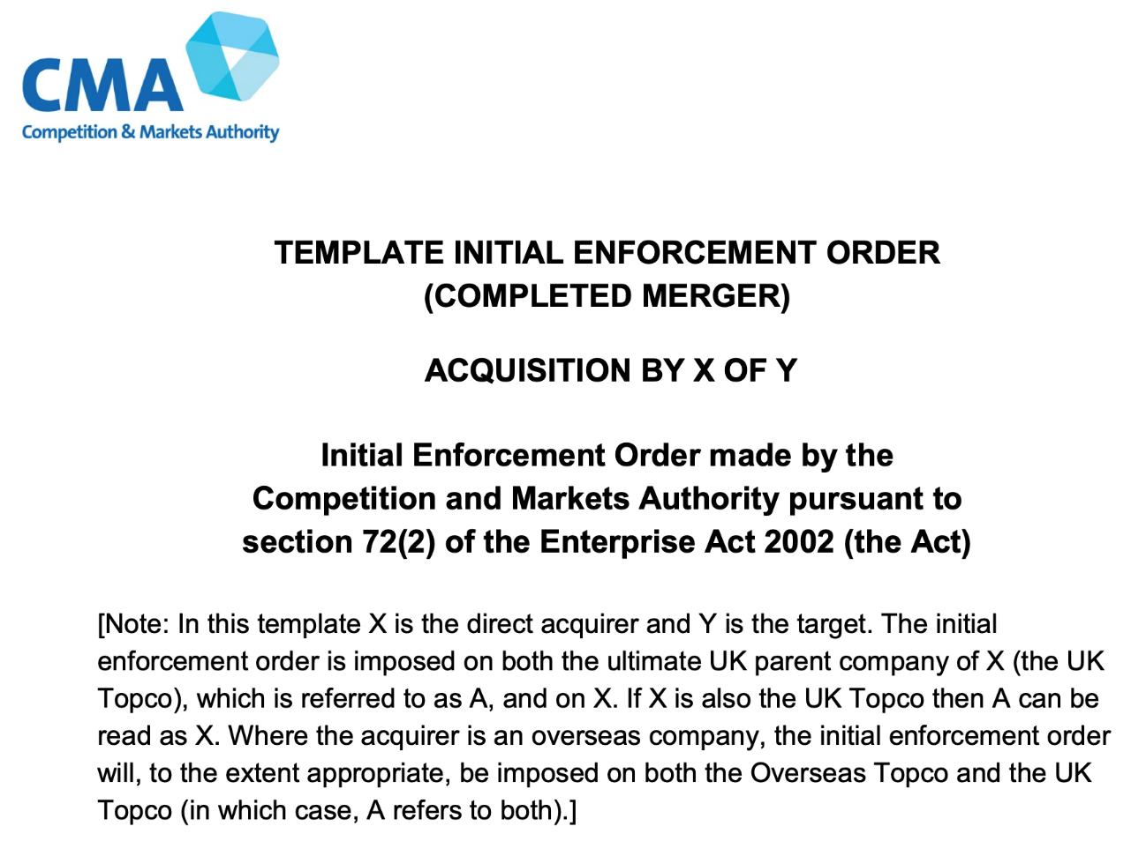
THE CMA’S TEMPLATE IEO
Imposes obligations on all addressees:
Not to take pre-emptive action or to integrate.
Not to make changes to “organisational structure”.
Not to change the “nature, description, range and quality” of UK goods or services.
Not to dispose of or encumber, any assets.
Not to make any changes to “key staff” (= positions of “executive or managerial responsibility”).
To take “all reasonable steps to encourage all key staff” to remain with their businesses.
Bi-weekly obligation to certify compliance with IEO.

Slide 19
DEROGATIONS: CUTTING THE TEMPLATE DOWN TO SIZE
Tribunal held in Facebook v CMA [2020] CAT 23:
        “The power to grant derogations is an important and necessary safeguard against, what may transpire on fuller information than it immediately available at the time of issue, to be unnecessarily wide and burdensome restrictions on businesses” ([27]).
Interim Measures Guidance sets out certain categories of derogation routinely granted, e.g. HR support, legal services, insurance coverage.
Derogations for parts of business unconnected to the merger: carve-outs for ‘international businesses’ in Amazon/Deliveroo and Paypal/iZettle (but not Facebook).

Slide 20
THE FACEBOOK CASE [2020] CAT 23
Facebook acquired GIPHY in May 2020.
CMA imposed template IEO on Facebook Inc, Facebook UK, all global Facebook subsidiaries and GIPHY on 9 June 2020.
Facebook said application of IEO to 50,000 global employees and hundreds of subsidiaries was unnecessary and disproportionate because Facebook assets could not form part of a final remedy.
CMA said it needed more detailed information about the Facebook business before deciding whether to grant the derogation.

Slide 21
THE FACEBOOK CASE: CAT JUDGMENT (1)
Tribunal’s operative finding was that the CMA had acted rationally in seeking further information ([132], [154]). Three interesting points of principle in the judgment:
First, ‘pre-emptive action’ is wider than conduct that could prejudice the CMA’s remedial options:
        “In the Tribunal’s view, the statutory purpose of s.72 EA02 is wider than the Applicants have contended. The definition of pre-emptive action is not grounded exclusively in the question of remedies. It includes action which might prejudice a Phase 2 reference. As the CMA submitted, this includes action that has the potential to affect the competitive structure of the market during the CMA’s investigation” ([124])
        “… interim measures play a vital role in allowing the CMA to ensure that, other than certain steps taken in the ordinary course of business, a merger and the actions of merging parties do not impact the pre-merger competitive structure of the market during the period of the CMA’s investigation” ([21]).

Slide 22
THE FACEBOOK CASE: CAT JUDGMENT (2)
Secondly, the CMA must act proportionately when imposing interim measures ([141]). But standard that applies to requesting further information less clear: “the standard of review is essentially equivalent to that given by the ordinary domestic standard of rationality, which is flexible and can be adjusted to take into account proportionality” ([148]).
Thirdly, no conclusion on Facebook’s point of principle that acquirer-side assets cannot be frozen under an IEO because they could not form part of a final merger remedy.
Note the Tribunal’s conclusion at [161]:
“In the light of the submissions and evidence filed in these proceedings, Facebook would appear to have good grounds for submitting that the IEO is unnecessarily wide and burdensome – a position which the CMA might ultimately find to be correct once the information it has requested has been provided and analysed.”

Slide 23
Competition Law Seminar Series: merger control
Tuesday 8 December 2020 @ 1pm online
Chaired by David Scannell QC
Aidan Robertson QC: recent merger decision challenges, including Tobii/Smartbox and JDSports/Footasylum
Sarah Ford QC: the temporal element of a ‘relevant merger situation’, including Lebedev and Hunter Douglas NV/247 Home Furnishings
Tom Pascoe: recent developments in the law on interim measures
Sarah Abram: merger control after the end of the Brexit transition period

