Slide 1
Fraud and corruption in international commercial arbitration
Neil Calver QC
Simon Salzedo QC

Slide 2
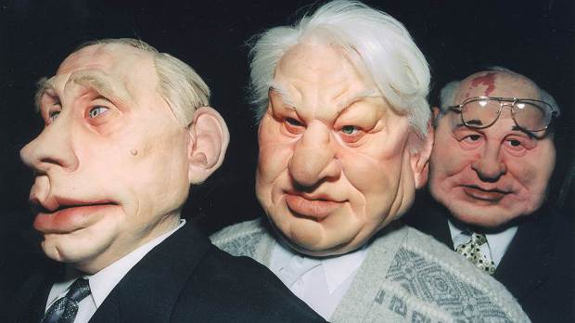
Early freezing injunction

Slide 3
Section 44(3) Arbitration Act 1996
(1)Unless otherwise agreed by the parties, the court has for the purposes of and in relation to arbitral proceedings the same power of making orders about the matters listed below as it has for the purposes of and in relation to legal proceedings.
(2)Those matters are—
(e)the granting of an interim injunction or the appointment of a receiver.
(3)If the case is one of urgency, the court may, on the application of a party or proposed party to the arbitral proceedings, make such orders as it thinks necessary for the purpose of preserving evidence or assets.

Slide 4
LCIA casework report 2017
Expedited formation of tribunal and appointment of emergency arbitrator
In 2017, there were a total of 16 applications for expedited appointment of a tribunal under Article 9A of the LCIA Rules 2014. Of the 16 applications, 4 were granted, 11 were rejected, and 1 was superseded.
These figures are similar to those of 2016, during which 15 applications were made, with 2 granted, and 2014, during which 10 applications were made, with 3 granted. 2015 stands as an outlier, with 30 applications made and 12 granted.
The LCIA also received 1 application for the appointment of an emergency arbitrator under Article 9B of the LCIA Rules 2014, which was rejected by the Court.

Slide 5
Security for the claim?
Article 25.1(i) LCIA Rules:
Article 25 Interim and Conservatory Measures 25.1 The Arbitral Tribunal shall have the power upon the application of any party, after giving all other parties a reasonable opportunity to respond to such application and upon such terms as the Arbitral Tribunal considers appropriate in the circumstances: (i) to order any respondent party to a claim or cross-claim to provide security for all or part of the amount in dispute, by way of deposit or bank guarantee or in any other manner;

Slide 6
LCIA casework report for 2017
Interim relief
In 2017, 68 applications for interim and conservatory measures under Article 25 of the LCIA Rules (involving 58 arbitrations) were made. Tribunals granted the relief in 17 instances and rejected the application in 30 others (in the other cases the applications were superseded).
Almost half of the applications were for security for costs under Article 25.2 of the Rules, of which 32% were successful (10 of 31). Security for costs applications therefore had the highest success rate of all types of applications (other than authorisation to seek relief from state courts or other legal authorities, for which only 2 applications were made). There were only 10 applications for security for the claim, of which only 2 were successful.

Slide 7
Section 103 Arbitration Act 1996
103 Refusal of recognition or enforcement
Recognition or enforcement of a New York Convention award shall not be refused except in the following cases
…
Recognition or enforcement of the award may also be refused if the award is in respect of a matter which is not capable of settlement by arbitration, or if it would be contrary to public policy to recognise or enforce the award.

Slide 8
Thank you

