Slide 1
The Importance of Forensic
Evidence
Michael Swainston QC
Brick Court Chambers
October 2017

Slide 2

Where the target is clear: e.g. Paintings (1)

Slide 3
Paintings (2)
  E.g. Knoedler Gallery, NY, NY
  Raman microscope (excitation laser, laser rejection filters, a spectrometer or monochromator allowing chemical imaging of minute points)
    Materials/pigment – implausibility;
    Extraneous clues – eg polypropylene fibre.
    Plus one “Pollok”

Slide 4
More Generally: The Challenge (1):
Spotting lies and liars is difficult
Vrij in “Detecting Lies and Deceit” (2007):
  “People tend to overestimate their own ability to detect lies (Elaad, 2003) and more lies remain unnoticed than they generally think...
  ... Research has indicated that even professional lie catchers ... often make incorrect decisions ...”

Slide 5
The Challenge (2): Discrimination
“... professional lie catchers ... perform at a level that is only slightly better than could be expected by chance when they identify truths and lies told by people unknown to them. They are somewhat better than laypersons at judging that someone is lying, but at the expense of correctly identifying truth tellers ...”

Slide 6
The Solution: Objective Evidence
Robert Goff LJ in The Ocean Frost [1985] 1 LL Rep 1at page 57, as follows:-
  “.... Speaking from my own experience, I have found it essential in cases of fraud, when considering the credibility of witnesses, always to test their veracity by reference to the objective facts proved independently of their testimony, in particular by reference to the documents in the case, and also to pay particular regard to their motives and to the overall probabilities. It is frequently very difficult to tell whether a witness is telling the truth or not ....”

Slide 7
The Challenge (3): Where to Look
Risk of falsehood ≡ what is at stake. Be alert.
Forensic targets are driven by issues, experience and instinct.
Techniques depend on targets.

Slide 8
Fake Documents
E.g. False Signatures/e.g. Transposition or Montage
No original (clue!)
The problem of photocopies
Identifying montage

Slide 9
Clues cont.
Trash marks
  Photocopiers have faults
  They produce extraneous marks on copies
  Compare – double = double copied
  Different = different machine
Differential degradation
  Copies deteriorate through noise each time
  Differential noise indicates different histories

Slide 10
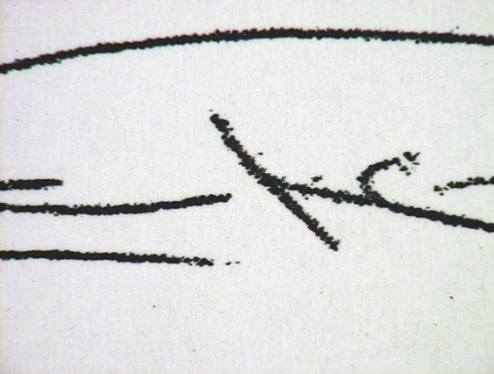
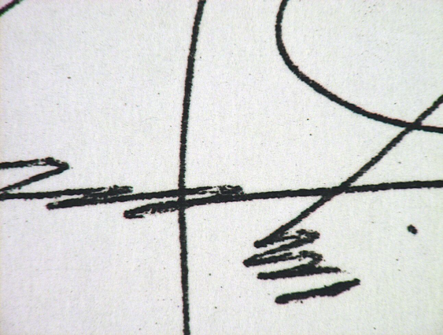
Clues (2)
Splatter (spatter) pattern
  Different printers produce more or less and different spatter (to the right or left of vertical lines)
  Different degradation and different preponderance of spatter = different histories.

Slide 11
Clues (3)
Age of ink:
  Composition and date of manufacture (Raman microscope etc)
Drying
  Note to fraudsters: biros are best.

Slide 12
Age of Signature
“Families” of signatures by time
Changes over time
Excuses:
    Coffee table
    Dupuytren's Contracture

Slide 13
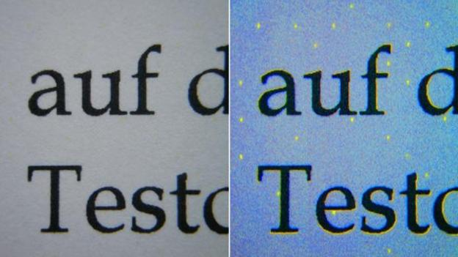
Breaking news - Yellow Dots: FBI/
/Reality Leigh Winner - 3/6/17
Dots from a HP Laserjet printer, illuminated with blue light (Credit: Florian Heise)

Slide 14
Who Wrote It?
RF challenge to the arbitration awards in Yukos;
One ground: report by Dr Carole Chaski, suggesting that the Tribunal Secretary had written most of an award.
Detailed linguistic and statistical analysis to identify authorship.

Slide 15
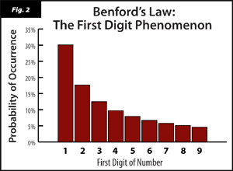
Is it Real ? - Benford’s Law

Slide 16
Digital Data: Pictures (1)
Digital manipulation generally more difficult to spot than analogue;
Digital files are often compressed: compression loses raw data and obstructs analysis;
Digital files can be created or manipulated with no (camera etc) fingerprints, or with false fingerprints added.

Slide 17
Pictures (2): Caution
UC Berkeley School of Law: in ICC work digital photos and videos “must be verified and authenticated and chain of custody must be established”.
ICC – “e-Court Protocol” requires full chain of custody of digital evidence, and identification of the person from whom the [document] originated.

Slide 18
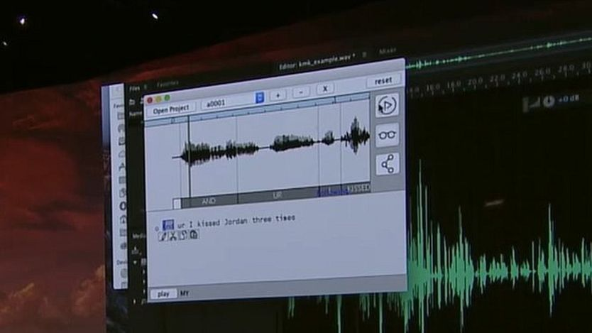
Digital Data: Sound
“Adobe Voco 'Photoshop-for-voice' causes concern” – BBC 7/11/16

Slide 19
Adobe Voco cont.,
BBC Technology (7/11/16):
“At a live demo in San Diego on Thursday, Adobe took a digitised recording of a man saying "and I kissed my dogs and my wife" and changed it to say "and I kissed Jordan three times".”

Slide 20
Fake News/Fake Evidence (1): Snowden

Slide 21
Fake News/Fake Evidence (2)

Slide 22
Fake News/Fake Evidence (3)

Slide 23
Conclusion
Be:
Cautious according to context and in proportion to what is at stake
Sceptical about evidence that is too good, too convenient or incongruous
Thorough in building chronologies and background to expose incongruity
Aware of techniques to test every kind of evidence
Resourceful in finding others
Determined not to let falsehood win.

Slide 24
Conspiracy Theories : Where next for the law on “unlawful means”?

Slide 25
Schenk v Cook [2017] EWHC 144 (QB) at [71]
“The components of the tort of conspiracy include:
an agreement or combination between two or more persons;
the intended consequence of which is to injure the Claimant;
the use of unlawful means; and
acts done in execution of that agreement which result in damage to the Claimant's trade or other interests”

Slide 26
The Unlawful Means Wars

Slide 27
Pre-2007 position
Very straightforward distinction
Powell v Boladz [1998] Lloyd’s Rep Med 116
  The unlawful means must be actionable
Then enter…

Slide 28
OBG v Allan [2008] 1 AC 1
Enormous judgment (re)considering many of the economic torts
Key question : in unlawful interference with economic interests, must the unlawful means be actionable?
Lord Hoffmann at [49] :
In my opinion, and subject to one qualification, acts against a third party count as unlawful means only if they are actionable by that third party. The qualification is that they will also be unlawful means if the only reason why they are not actionable is because the third party has suffered no loss. In the case of intimidation, for example, the threat will usually give rise to no cause of action by the third party because he will have suffered no loss. If he submits to the threat, then, as the defendant intended, the claimant will have suffered loss instead. It is nevertheless unlawful means. But the threat must be to do something which would have been actionable if the third party had suffered loss.

Slide 29
Customs & Excise Commissioners v Total Network SL [2008] UKHL 19
T was a Spanish company with a UK bank account.
Classic “intra-community missing trader”, or “carousel”, fraud
Total sells phones to UK company, which are eventually sold back to them, after the VAT has been reclaimed
HMRC claimed against Total in unlawful means conspiracy
Side issue about Article 4 of the Bill of Rights

Slide 30
Customs & Excise Commissioners v Total Network SL [2008] UKHL 19
Key q : could the crime of “cheating the revenue” be unlawful means?
Answer : sometimes
Lord Mance at [100] : “The intentional harm tort and the “unlawful means” variety of conspiracy share the ingredients of the intentional infliction of harm on the claimant. But that variety of conspiracy is not simply the intentional harm tort committed by joint tortfeasors. The gist of the intentional harm tort (apart from exceptional “two party” cases) is striking at the claimant through a third party, and doing so by interfering with his freedom of economic activity. The gist of conspiracy is damage intentionally inflicted by persons who combine for that purpose …and the claimant need not be a trader who is injured in his trade, though that is the most common case. In my opinion your Lordships are driven to the conclusion that, as the economic torts have developed, “unlawful means” has a wider meaning in the tort of conspiracy than it has in the intentional harm tort.”

Slide 31
Recent cases on unlawful means

Slide 32
The Open Questions
No test for deciding what qualifies as “unlawful means”
  Crimes, torts, breaches of statutory duty, vitiating factors in a contract?
The two-party and the three-party cases
  Lord Hope at [43], Lord Walker at [99], Lord Mance at [124], and Lord Neuberger at [224]
  BUT assumption in subsequent judgments

Slide 33
Digicel v Cable & Wireless PLC [2010] EWHC 774 (Ch)
C&W had statutory monopolies on telecoms in various Caribbean jurisdictions
Had failed to open up markets as required
In particular, alleged they had deliberately delayed permitting “interconnection”
Non-actionable breaches of a non-criminal statute : not unlawful means
Annex 1 : Impressive analysis of conspiracy
  [53] : Not all crimes are unlawful means
  [58] : The need to proceed in incremental steps

Slide 34
Other recent examples:
BA v Emerald Supplies [2015] EWCA Civ 1024 : Foreign competition statutes?
  Be wary of the elegant solution : this is a public policy point
Ablyazov (No.12) [2017] EWCA Civ 40 : Contempt of court?
Avonwick Holdings v Castle Investment Fund [2016] EWCA Civ 819 : Transactions at an undervalue under Insolvency Act 1986

Slide 35
A villain looking for a doctrine?
Avonwick : Suggests double actionability isn’t a problem?
  See also Concept Oil Services v En-Gin Group [2013] EWHC 1897 (Comm)
BUT Wagner v Gill [2014] NZCA 336 : Breach of directors’ duties owed to another company not actionable
Marex Financial v Sevilleja [2017] EWHC 918 (Comm) at [37]-[40] : Reflective loss doctrine disapplied in asset-stripping cases using economic torts

Slide 36
The position abroad
Canada : AI Enterprises v Bram Enterprises [2014] 1 SCR 177
Singapore : Simgood Pte Ltd v MLC Shipbuilding Sdn Bhd and others [2015] SGHC 303
New Zealand : Wagner v Gill [2014] NZCA 336

Slide 37
Questions

Slide 38
Fraud in Letter of Credit Cases
Joanne Box
Brick Court Chambers

Slide 39
RD Harbottle v National Westminster Bank
[1978] QB 146, 155
Kerr J:
“It is only in exceptional cases that the courts will interfere with the machinery of irrevocable obligations assumed by banks. They are the lifeblood of international commerce. Such obligations are regarded as collateral to the underlying rights and obligations between the merchants at either end of the banking chain. Except possibly in clear cases of fraud of which the banks have notice, the courts will leave the merchants to settle their disputes under the contracts by litigation or arbitration as available to them or stipulated in contracts.”
2

Slide 40
Petrosaudi Oil Services (Venezuela) Ltd v Novo Banco SA
[2016] EWHC 2456 (Comm)
HHJ Waksman QC
“We certify that the applicant is obligated to the beneficiary to pay the amount demanded under the drilling contract”
[64]-[65]: no sum was due and payable
3

Slide 41
[88]: “I think that the interpretation said to have been honestly believed in by Mr Buckland is something of a lawyer’s construct that does not in fact bear serious scrutiny notwithstanding the lengthy and detailed argument upon it which has been advanced before me. I regret to say that I do not accept that Mr Buckland really and honestly believed it. In my judgment he knew in truth that PDV was not obligated in the obvious sense required by the certificate. The fact that he may have thought that an argument or even a strong argument could be put forward to justify the certificate by means of the different interpretation of “obligated” is irrelevant. He himself had to believe in that different interpretation so as to render the certificate true, as Mr Bools QC accepted in argument. But, in my judgment, he did not so believe.”
[89]: “If he did not know that his certificate was false for the reasons given above, then he was certainly reckless as to its falsity, in my judgment. If, contrary to my findings above, he really did not even consider the temporal aspect, then that could only be by wilfully shutting his eyes to the obvious.”
4

Slide 42
Petrosaudi Oil Services (Venezuela) Ltd v Novo Banco SA
[2017] EWCA Civ 9
Christopher Clarke LJ, Lewison LJ
[55]: “The SBLC is to be interpreted by seeking to discern the intention of the parties by reference to what a reasonable person with all the relevant background knowledge would have understood the language used by the parties to mean and, having regard, inter alia, to commercial common sense. The commercial background included the following. Prompt and regular payments under remote drilling contracts are essential to a contractor’s cash flow and the parties’ intention was that there should be a steady stream of such payments. At the time of the drilling contract PDVSA, an emanation of the Venezuelan State, had a long-established reputation for late payment, or even non-payment, of contractors. Given that history the agreement to provide an SBLC was an essential precondition to POS and its financiers’ willingness to enter into the drilling contract. The purpose of a letter of credit is to ensure that the beneficiary can obtain from a bank sums due under the main contract regardless of the fact that there is a dispute between the parties to that contract as to whether those sums are in fact due. The function of a letter of credit is to reverse the risk of non-payment from the payee to the payor.”
5

Slide 43
[68]: “In my judgment, in the particular circumstances of this case, a statement that PDVSA was obligated to pay must be taken to mean that the obligation to pay has accrued due so that PDVSA had become liable to make the payment, even though precluded from discharging that liability until the Article 141 procedure had been complied with or an award made…”
[80]: “In my judgment, the judge was wrong to conclude that PDVSA was under no obligation under the drilling contract to pay any invoice submitted by POS; and that Mr Buckland on behalf of POS was not entitled to certify that PDVSA was obligated to pay POS the amount of those invoices.”
[81]: “It follows that in signing the certificate Mr Buckland was not fraudulent in any sense. On the contrary he was entitled to sign it. He was not dishonest.”

Slide 44
[88]: “I wish, however, to express some disquiet at the finding of the judge that, on the view that he took of the legal position, Mr Buckland was fraudulent in signing the certificate. Whilst there is only one true construction of an instrument such as the certificate, different legal minds may obviously take different views on such a question. Had it been necessary to do so I would wish to have given anxious consideration to the question whether, despite the well-recognised advantages of a trial judge and the inhibition rightly felt by this court in overturning findings of fact, the judge was entitled to conclude that Mr Buckland was fraudulent (i.e. conscious of the falsity of what he was saying or with no honest belief in, or a reckless indifference to, its truth) in holding the view that I currently hold, when making what was, in essence, a representation of law…”

Slide 45
National Infrastructure Development Co Ltd v Banco
Santander SA [2017] EWCA Civ 27
Longmore LJ, Christopher Clarke LJ
Summary judgment test: real prospect of showing that the only realistic inference is that the beneficiary could not honestly have believed in the validity of its demands under the letter of credit. [24]
C.F. Interim injunction test: it must be clearly established at the interlocutory stage that the only realistic inference is that the beneficiary could not honestly have believed in the validity of its demands under the letter of credit: Alternative Power Solution Ltd v Central Electricity Board [2014] UKPC 31 per Lord Clarke [59]

Slide 46
[38]: “Mr Russen submitted that there was no evidence that personnel at NIDCO had addressed their minds to the question whether sums were presently “due and owing” or would become “due and owing” at some future date and that he should be entitled to cross-examine them to try to establish that they were reckless as to that distinction, such recklessness amounting to fraud in the Derry v Peek sense. No doubt lawyers can have a debate as to whether a current entitlement to claim damages for repudiation entitles one to say that the amount of such damages is due and owing (and I have summarised my own views on that interesting question above) but it borders on the absurd to say that the only realistic inference from the fact that businessman did not have (or may not have had) that debate is that they could not have believed in the validity of their demands.”

Slide 47
Pre-Action Disclosure
Out of the Jurisdiction
Alec Haydon
Brick Court Chambers
Commercial Conference on Civil Fraud
12 October 2017

Slide 48
Two Potential Types of Respondent
The Need for Pre-Action Disclosure
● Need to identify the wrong-doer.
● Uncertainty as to whether there was a fraud at all.
● A person caught up in the wrong-doing of others (Norwich Pharmacal).
● A person “likely” to be a party to subsequent proceedings (CPR 31.16).

Slide 49
Service of a Claim Form
Seeking Norwich Pharmacal Relief
Out of the Jurisdiction

Slide 50
AB Bank Ltd v Abu Dhabi Commercial Bank PJSC
[2016] EWHC 2082 (Comm), Teare J.
AB Bank was a Bangladeshi bank which had deposited $20m with ADCB in a joint account with Pinnacle.
Over a period of a few months, persons unknown withdrew the money.
AB Bank could sue Pinnacle here under an exclusive jurisdiction clause.
ADCB was not alleged to have been a party to the fraud but was believed to have information sufficient to identify the recipients of the money which would support a proprietary claim.

Slide 51
No Gateway for Norwich Pharmacal Relief
No gateway under PD6B, paragraph 3.1(5) which permits service out of the jurisdiction for a claim that is an “interim remedy” under section 25(1) of the CJJA 1982 because:
  S.25(1) provides for interim relief in support of foreign proceedings (not domestic proceedings); and
  Norwich Pharmacal does not provide interim relief , even if granted ex parte.
  (It is a self-standing cause of action and relief is final as between the parties).
No gateway under PD6B, paragraph 3.1(2) which permits service out of the jurisdiction where there is a “claim for an injunction” ordering the Defendant “to do or refrain from doing an act within the jurisdiction” because ADCB could comply abroad.
No gateway under PD6B, para 3.1(3) (“necessary or proper party”) as ADCB was not liable to AB Bank on the facts alleged and a party cannot be joined only to obtain disclosure (decision of Eady J. in Lockton Companies International not followed).

Slide 52
Service of an Application Form for relief under CPR 31.16
Out of the Jurisdiction

Slide 53
Section 33(2) Senior Courts Act 1981
“On the application, in accordance with rules of court, of a person who appears to the High Court to be likely to be a party to subsequent proceedings in that court ... the High Court shall, in such circumstances as may be specified in the rules, have power to order a person who appears to the court to be likely to be a party to the proceedings and to be likely to have or to have had in his possession, custody or power any documents which are relevant to an issue arising or likely to arise out of that claim –
(a) to disclose whether those documents are in his possession, custody or power; and
(b) to produce such of those documents as are in his possession, custody or power to the applicant ....”

Slide 54
CPR 31.16
“(3) The court may make an order under this rule only where-
(a) the respondent is likely to be a party to subsequent proceedings;
(b) the applicant is also likely to be a party to those proceedings;
(c) if the proceedings had started, the respondent’s duty by way of standard disclosure, set out in rule 31.6, would extend to the document or classes of documents of which the applicant seeks disclosure; and
(d) disclosure before proceedings have started is desirable in order to-
(i) dispose fairly of the anticipated proceedings;
(ii) assist the dispute to be resolved without proceedings; or
(iii) save costs.”

Slide 55
Is there a Gateway?
There is no power to serve an application for pre-action disclosure out of the jurisdiction: Documentary Evidence (12th edition, 2015), 1-27.
Hollander QC considers PD6B, paragraph 3.1(2) unlikely to succeed (injunction requiring an act within the jurisdiction) – cf. AB v ADCB.
Blair J. (obiter) had “considerable doubts” about there being any jurisdiction in Clermont Energy Partners LLP v SDP Services Limited [2016] EWHC 1328.
Look out for the anticipated decision in ED&F Man Capital Markets LLP v Obex (Comm Court) in which the applicant has relied on paragraph 3.1(20).

Slide 56
PD 6B, para 3.1(20)
“3.1 The claimant may serve a claim form out of the jurisdiction with the permission of the court under rule 6.36 where-
(20) A claim is made – under an enactment which allows proceedings to be brought and those proceedings are not covered by any of the other grounds referred to in this paragraph”
Is Section 33(2) of the Senior Courts Act 1981 an “enactment which allows proceedings to be brought”?
Or is it one which “more simply provides for a particular remedy within proceedings whose legal basis is found elsewhere.”? (See Rix LJ, obiter, on section 37 of the Senior Courts Act 1981 – injunctions – AES Ust-Kamenogorsk Hydropower Plant LLP v Ust-Kamenogorsk Hydropower Plant JSC [2012] 1 WLR 920 (CA).

Slide 57
Commercial Fraud – Law & Practice
Brick Court Chambers
12th October 2017

