Slide 1
Telecommunications: some changes in the pipeline
Brick Court Chambers
7 March 2018

Slide 2
The new standard of review on appeals against OFCOM to the CAT
Sarah Ford QC
Brick Court Chambers
7 March 2018

Slide 3
Out with the old …
Section 195 (2) Communications Act 2003:
“The Tribunal shall decide the appeal on the merits and by reference to the grounds of appeal set out in the notice of appeal.”

Slide 4
…and in with the new
Section 194A(2) Communications Act 2003 – inserted by s. 87 Digital Economy Act 2017 with effect from 31 July 2017 (SI 2017/765 reg. 2(w)):
“The Tribunal must decide the appeal, by reference to the grounds of appeal set out in the notice of appeal, by applying the same principles as would be applied by a court on an application for judicial review.”

Slide 5

BAA Ltd v Competition Commission
[2012] CAT 3 at [20]

Slide 6

How to give your appeal some teeth?

Slide 7

Article 4(1) Framework Directive
T-Mobile (UK) Ltd & Anor v
Office of Communications
[2009] 1 WLR 1565

Slide 8

Convention rights
“In some contexts where Convention rights are in issue and the obligation on a public authority is to act in a manner which does not involve disproportionate interference with such rights, the requirements of investigation and regarding the evidential basis for action by the public authority may be more demanding.” BAA Ltd v CC [2012] CAT 3 at [20](5)

Slide 9

Use of power for an improper purpose
“The statutory powers conferred on [public] authorities to be exercised for public purposes can only be validly used if they are used in the way which Parliament, when conferring the powers, is presumed to have intended.”
Credit Suisse v Allerdale Borough Council [1997] QB 306, 333 per Neill LJ

Slide 10

Jurisdictional or precedent fact
“Where the exercise of …power depends upon the precedent establishment of an objective fact, the courts will decide whether the requirement has been satisfied.” R (A) v Croydon London Borough Council [2009] 1 WLR 2557 at [30]; Societe Cooperative de Production SeaFrance SA v CMA [2015] Bus LR 1573 at [31].

Slide 11
Thank you
Sarah Ford QC
www.brickcourt.co.uk

Slide 12
The aim of the new standard of review
(and how to actually achieve it)
Sarah Love
Brick Court Chambers
7 March 2018

Slide 13
“Houston, we have a problem.”

Slide 14
Hansard, 27.10.16
“Currently, appeals can be brought and decided on the merits of a case, and this exceeds and effectively gold-plates article 4 of the EU framework directive that requires that the merits of a case are taken into account in any appeal.”

Slide 15
“The result of this over-implementation is an unnecessarily intensive and burdensome standard of review that can result, as the hon. Lady set out, in very lengthy and costly appeals litigation, which can hinder timely and effective regulation, and risks Ofcom taking an overly risk-averse approach to regulating the sector properly.”

Slide 16
Explanatory Notes to the Digital Economy Bill
“43. The government believes that the existing “on the merits” standard of review is overly burdensome. A 2013 analysis by the Department for Business, Innovation & Skills found that the average length of an appeal to the CAT reviewed “on the merits” was ...

Slide 17
...11 months.”

Slide 18
“Faster, Better, Cheaper”

Slide 19
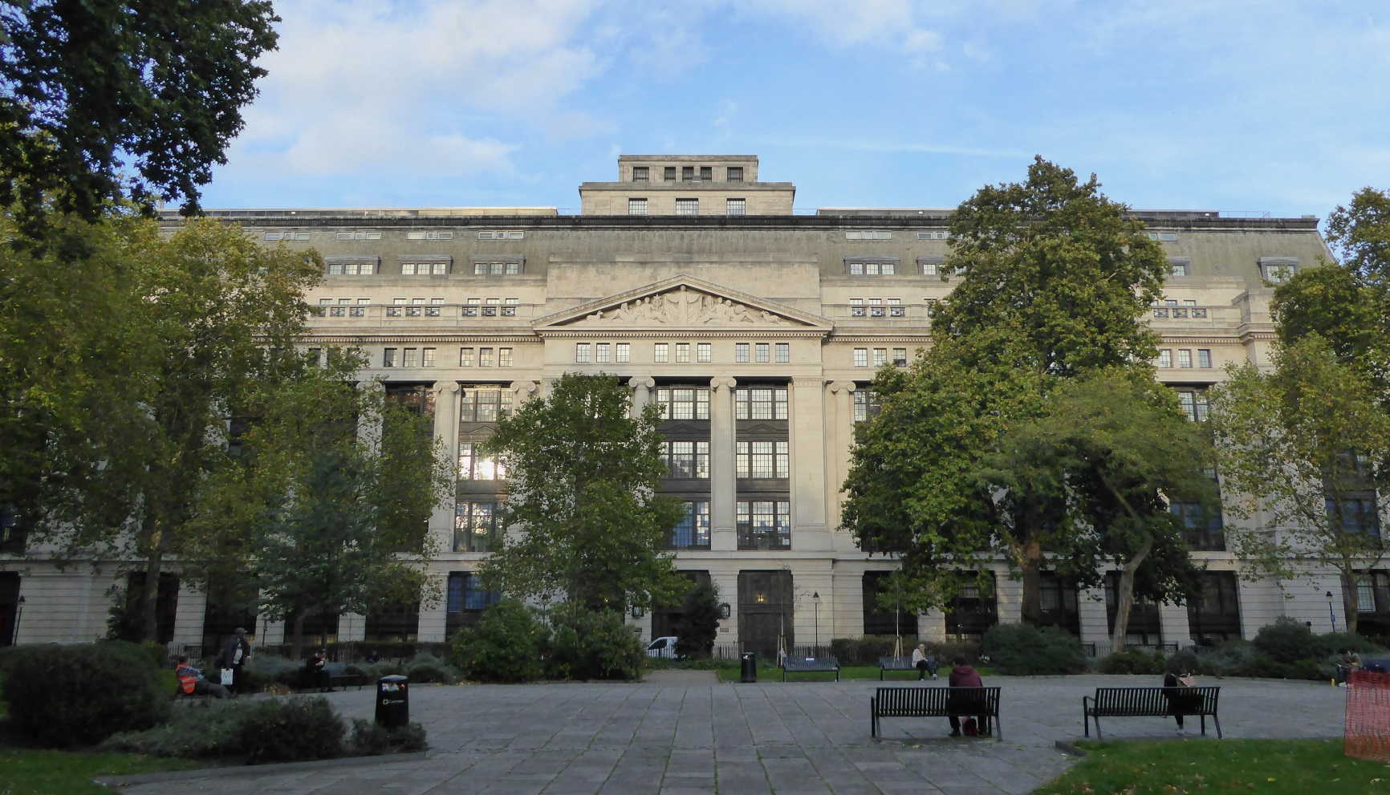
From...
Victoria House, Bloomsbury, photo by Ethan Doyle White; CC-BY-SA-4.0

Slide 20

...to...
Kennedy Space Center; photo by Gillfoto; CC-BY-SA-3.0

Slide 21

(1) Grounds of appeal
Falcon 1 Flight 4 lift-off; photo by SpaceX; CC-BY-SA-3.0-migrated

Slide 22

(2) Use of expert evidence
Hand holding a pencil; photo by Johnny Magnusson; CC0 1.0

Slide 23
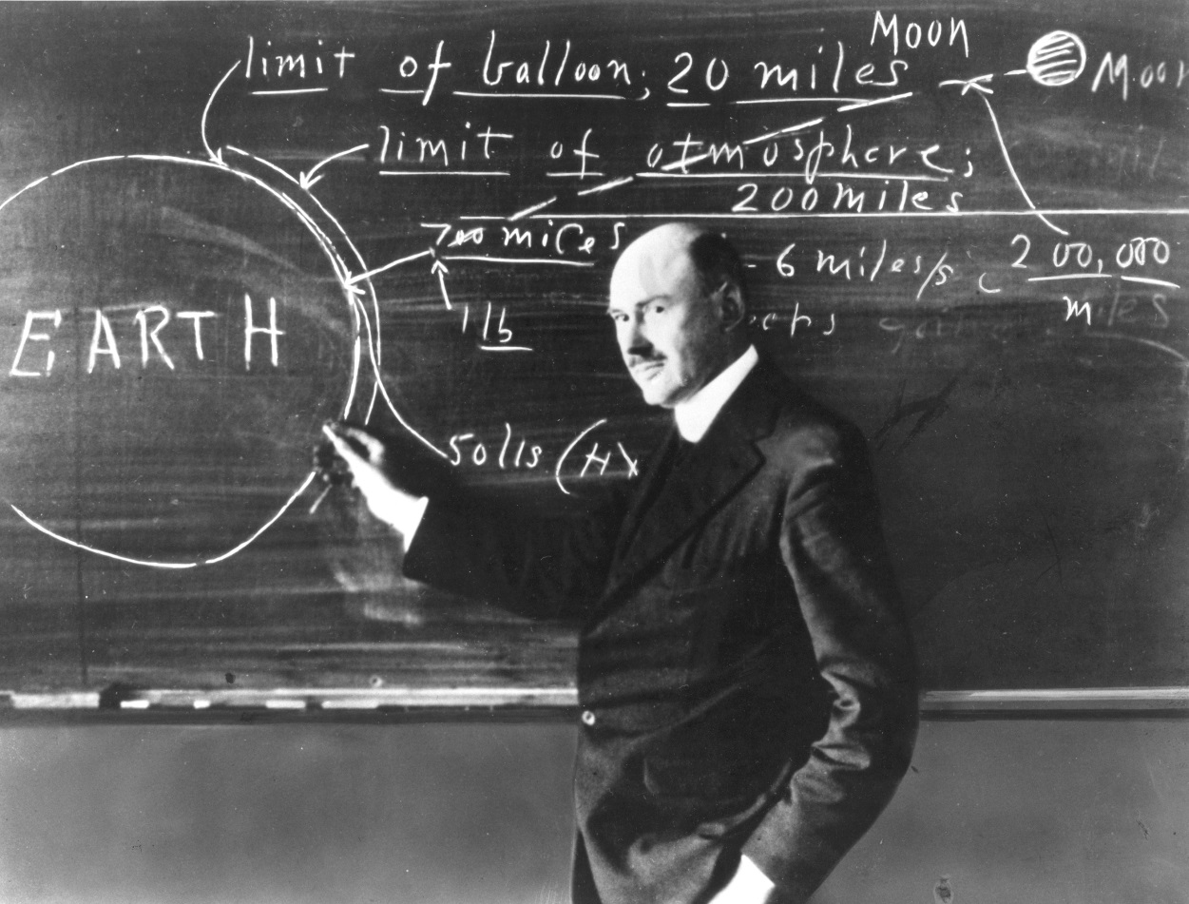
(3) Teach-ins
Dr Robert Goddard at a blackboard; photo from Great Images in NASA; PD-USGov

Slide 24

India’s Mars Orbiter Mission spacecraft; image by Kevin Gill; CC-BY-SA-2.0

Slide 25
Thank you
Sarah Love
www.brickcourt.co.uk

Slide 26
Telecommunications: some changes in the pipeline
Brick Court Chambers
7 March 2018

