Slide 1
Litigating Abuse of Dominance cases mini series
Thursday 22 April at 1pm, Session 2:
Abuses & pharmaceuticals: recent & current issues in litigation
chaired by Lord Anderson of Ipswich KBE QC
Jemima Stratford QC
David Scannell QC
Tom Pascoe

Slide 2
Litigating Abuse of Dominance cases mini series
Monday 12 April at 5pm, Session 1: Recap on main substantive developments of practical interest for litigation, chaired by Dame Kelyn Bacon DBE
Thursday 22 April at 1pm, Session 2: Abuses & pharmaceuticals: recent & current issues in litigation, chaired by Lord Anderson of Ipswich KBE QC
Wednesday 28 April at 1pm, Session 3: Litigating big tech/big data abuses, chaired by Sir Nicholas Forwood
Friday 7 May at 1pm, Session 4: Interim injunctions in abuse of dominance cases: strategy and tips, chaired by Sir Richard Aikens
Tuesday 11 May at 1pm, Session 5: Regulatory appeals, chaired by Sir Gerald Barling

Slide 3
Abuses and pharmaceuticals: MARKET DEFINITION
Jemima Stratford QC

Slide 4
Market Definition as a Tool

Slide 5
Geographic market
An issue to watch post Brexit?

Slide 6
Product market: issue (1) – potential competition
Commission 1997 Notice on Market Definition
Consultation on revision of the Notice
Para 24:
“… potential competition is not taken into account when defining markets, since the conditions under which potential competition will actually represent an effective competitive constraint depend on the analysis of specific factors and circumstances related to the conditions of entry. If required, this analysis is only carried out at a subsequent stage, in general once the position of the companies involved in the relevant market has already been ascertained, and when such position gives rise to concerns from a competition point of view.”
Case C-307/18 GSK (paroxetine) – a new approach?

Slide 7
Product market: issue (2) – Servier and therapeutic substitutability
Case T-691/14, EU:T:2018:922 Servier
ATC Levels:
ATC3 = all pharmaceutical products with the same therapeutic indications
ATC4 = therapeutic and pharmacological subdivision having regard to molecule class, formulation or mode of action
ATC5 = individual active substances.
Commission – market – ATC5, perindopril (patent-protected and generic)
GC – market defined more widely – ACE inhibitors
? CJEU

Slide 8
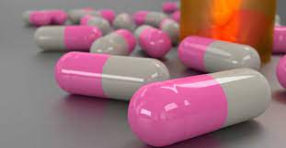
Product market: issue (2) contd – Servier and therapeutic substitutability
Astra Zeneca still relevant?
Way market defined in previous case not legally binding: Cases T-346/02, etc, Cableuropa v Commission [2003] ECR II-4251, EU:T:2003:256, para 191 and Clearstream Banking v Commission para 55.

Slide 9
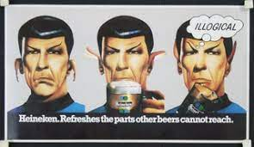
Product market: issue (3) – practical reality and public policy
Effect on settlements?
Intellectual parameters of market definition being stretched?
Dominance at time of greatest risk of generic entry?
Is competition law trying to do too much?

Slide 10
Abuses and pharmaceuticals: Generics (UK) Ltd. v CMA (Paroxetine)
David Scannell QC

Slide 11
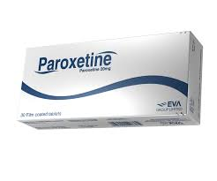
Generics (UK) Ltd. v CMA
CAT pre-preliminary reference Judgment: [2018] CAT 4
Preliminary Ruling: Judgment of 30/1/20 in C-307/18, EU:C:2020:52
CAT’s final Judgment – imminent

Slide 12
Abuse – the basics (1)
1. Definition
“an objective concept relating to the behaviour of an undertaking in a dominant position which is such as to influence the structure of a market where, as a result of the very presence of the undertaking in question, the degree of competition is weakened and which, through recourse to methods different from those which condition normal competition in products or services on the basis of the transactions of commercial operators, has the effect of hindering the maintenance of the degree of competition still existing in the market or the growth of that competition.”
(Judgment of 6 December 2012 in AstraZeneca v Commission, C-457/10 P, EU:C:2012:770, paragraph 74. Judgment of 13 February 1979 in Hoffmann-La Roche v Commission, C-85/76, EU:C:1979:36, paragraph 91; Judgment of 19 April 2012 in Tomra Systems v Commission, C-549/10 P, EU:C:2012:221, paragraph 17; Judgment of 30 January 2020 in Generics (UK) (Paroxetine), paragraph 148. This passage has since often been cited in the European Courts and in the CAT. For example, see Genzyme Ltd v Office of Fair Trading [2004] CAT 4, at [482]-[484]. See also the Court of Appeal in Napp Pharmaceuticals Holdings Ltd v Director General of Fair Trading [2002] EWCA Civ 796, paragraphs 22–24.)

Slide 13
Abuse – the basics (2)
Each case is “highly fact sensitive and dependent upon an evaluation of a wide range of factors”
National Grid plc v Gas and Electricity Markets Authority [2010] EWCA Civ 114, [54]
Test (effects-based)
“The conduct is reasonably likely to harm the competitive structure of the market”
Stretmap.Eu Ltd v Google [2016] EWHC 253 (Ch.), per Roth J, at [88]
Justification
Conduct is objectively necessary
Exclusionary effect is counterbalanced by advantages in terms of efficiency gains that benefit consumers
Judgment in Post Danmark A/S, C-209/10, EU:C:2012:172, [40]-[41]

Slide 14
Generics (UK) - Pre-reference Judgment (CAT)
Pre-reference Judgment (8 March 2018):
[410]
“Insofar as the finding of abuse concerns GSK’s entry into the [the settlements challenged under Chapter I], it effectively depends on the same grounds as those relied on to establish a breach of the Chapter I prohibition”
[279]
“We […] note that there is no suggestion in the evidence that this reduction in price paid by the NHS formed any part of the intention of the parties when entering into any of the Agreements […]”

Slide 15
Preliminary Reference – Referred Abuse Qs
“Abuse
(8) In the circumstances set out in Questions 3-5 above, if the patent holder is in a dominant position, does its conduct in entering into such an agreement constitute an abuse within the meaning of Article 102 [TFEU]?
(9) Does the answer to Question 8 differ if the patent holder makes an agreement of that kind not in settlement of actual litigation but to avoid litigation being commenced?
(10) Does the answer to Question 8 or 9 differ if:
(a) the patent holder pursues a strategy of entering into several such agreements to preclude the risk of unrestricted generic entry; and
(b) the consequence of the first such agreement is that by reason of the structure of the national arrangements for reimbursement by the public health authorities to pharmacies of their costs of purchasing pharmaceutical drugs, the reimbursement level for the pharmaceutical drug in question is reduced, resulting in a substantial saving to the public health authorities (albeit a saving which is significantly less than that which would arise upon independent generic entry following a successful outcome for the generic company in patent litigation); and
(c) that saving was no part of the intention of the parties when entering into any of the agreements?”

Slide 16
Preliminary Ruling - Abuse
Preliminary Ruling, 30/1/2020, C-307/18, at [172]
“[…] the strategy of a dominant undertaking, the holder of a process patent for the production of an active ingredient that is in the public domain, which leads it to conclude […] a set of settlement agreements which have, at the least, the effect of keeping temporarily outside the market potential competitors who manufacture generic medicines using that active ingredient, constitutes an abuse of a dominant position within the meaning of Article 102 TFEU, provided that that strategy has the capacity to restrict competition and, in particular, to have exclusionary effects, going beyond the specific anticompetitive effects of each of the settlement agreements that are part of that strategy, which it is for the referring court to determine.”

Slide 17
Abuses and pharmaceuticals: excessive pricing
Tom Pascoe

Slide 18
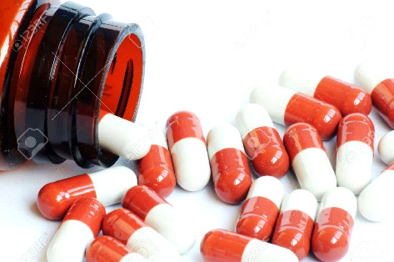
History of excessive pricing
Isolated previous cases: Pompes Funebres (funerals), Attheraces (horse racing data), Albion Water (water supply), Latvian Copyright (music licensing).
Recent pharmaceutical cases:
Flynn/Pfizer – phenytoin (epilepsy). Investigation opened in May 2013. Still under investigation after successful appeal.
Concordia - liothyronine (thyroid conditions). Investigation opened in October 2016. Still at SO stage.
Actavis - hydrocortisone (steroid). Investigation opened in March 2016. Still at SO stage.
Aspen - European Commission investigation into cancer drugs. Decision published last week.
Hand sanitiser products – opened June 2020 and already closed.

Slide 19
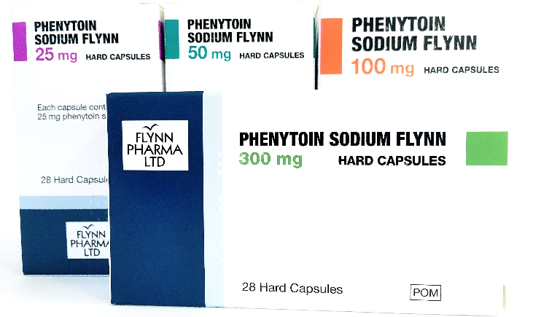
Phenytoin: Facts (1)
First of the pharmaceuticals investigations to reach the CAT.
Phenytoin sodium – a drug used to treat epilepsy.
Has a “Narrow Therapeutic Index” – limited switching.
Before 2012 sold by Pfizer at a loss under the PPRS scheme.
Acquired by Flynn in 2012 and released from PPRS.

Slide 20
Phenytoin: Facts (2)
Prices rise as a result of removal of phenytoin from PPRS:
Pfizer and Flynn benchmarked their prices to price of phenytoin tablet already on the market (“the Teva Tablet”).

Slide 21
Phenytoin: CMA’s approach
The CMA found:
A reasonable rate of return for a drug like phenytoin is 6% ([259-64]).
The 6% figure was based on what branded drugs are (supposedly) allowed to earn under the PPRS, and backed up by economic theory ([332]).
It was not necessary to examine the price of comparable products because Pfizer’s and Flynn’s prices were “unfair in themselves”.
Fines of £85m and £5m imposed on Pfizer and Flynn, respectively.

Slide 22
Phenytoin: The ‘benchmark price’
Competition Appeal Tribunal held at [324]:
“In summary, setting a benchmark price (or range) would have enabled the CMA to adopt a less rigid approach to its analysis. This may have meant it would have examined the various candidate comparator products more carefully (using a weighted approach for relevance rather than a binary approach as to whether a comparator was helpful or not); it may also have led to less reliance being placed on the PPRS, with which we deal below. It may also have led the CMA to examine what returns might have been under normal competitive conditions, rather than … looking for a rate of return reflecting that which would be more appropriate to conditions of idealised competition.”

Slide 23
Historic prices
Prices in other markets
Returns on Flynn’s other products
Profits earned by other generic companies
Teva Tablet
Other anti-epileptic drugs
“Normal competitive price”

Slide 24
Phenytoin: “Economic value” for patients
“[W]here … the buyer is medically dependent, to a degree, on the supply, it does not follow that the value to be attributed to the demand side is zero … Placing a precise monetary value on patient benefit is not straightforward but it appears to us that a qualitative assessment would be possible and should have been attempted by the CMA rather than simply assessing this value as nil.” ([416]-[419])
Economic value
Demand
“Dependency”

Slide 25
The Aspen Decision
Concerned six old cancer drugs. Aspen acquired the drugs from GSK and increased the prices.
“The Commission analysed the profitability of a sample of undertakings that are similar to Aspen and for which the Commission has no indications that they do not operate under conditions of sufficiently effective competition” (128).
Found a median gross margin of 54% and EBITDA of 23% for other generic-focused companies.
But “not every deviation from the median or average profitability in an industry results directly in excessiveness”. Only profits “significantly exceeding the median” can be excessive (132) and (136).

Slide 26
Q: How do you decide what is a fair, or unfair, price for a life-changing drug?
A: Ask someone in the industry what prices are charged in the real-world. Don’t ask an economist what prices should be charged in theory.

Slide 27
Litigating Abuse of Dominance cases mini series
Thursday 22 April at 1pm, Session 2:
Abuses & pharmaceuticals: recent & current issues in litigation
chaired by Lord Anderson of Ipswich KBE QC
Jemima Stratford QC
David Scannell QC
Tom Pascoe

