Slide 1
Arbitration mini series
Friday 30 April at 12.30pm, Session 1:
Jurisdiction: Section 9 challenges and the Tribunal’s jurisdiction over third parties
chaired by Fionn Pilbrow QC
Jasbir Dhillon QC
Fred Hobson
Ben Woolgar

Slide 2
Stays under s.9 Arbitration Act 1996
Ben Woolgar

Slide 3
s.9 itself
"(1) A party to an arbitration agreement against whom legal proceedings are brought (whether by way of claim or counterclaim) in respect of a matter which under the agreement is to be referred to arbitration may (upon notice to the other parties to the proceedings) apply to the court in which the proceedings have been brought to stay the proceedings so far as they concern that matter….
(4) On an application under this section the court shall grant a stay unless satisfied that the arbitration agreement is null and void, inoperative, or incapable of being performed."

Slide 4
Key principles
Based on Article II of the New York Convention
The stay is mandatory, not discretionary
The agreement is one not only to arbitrate, not also not to litigate : Bridgehouse (Bradford No 2) Ltd v BAE Systems PLC [2020] EWCA Civ 759
Burden under s.9(1) is on applicant, but burden on s.9(4) is on respondent
Standard of proof:
Under s.9(1), balance of probabilities/final decision
Under s.9(4), context-sensitive : see JSC Aeroflot Airlines v Berezovsky [2013] EWCA Civ 784

Slide 5
How the Court decides
Kompetenz-kompetenz vs. English court’s duty
The three (?) options (Al-Naimi v Islamic Press Agency Inc [2000] 1 Lloyd’s Rep 522)
Decide the issue in a summary fashion
Order a trial of the issue under CPR r.62.8(3)
Stay under its inherent jurisdiction
Try a preliminary issue
Stay under the inherent jurisdiction = a high threshold : see Republic of Mozambique v Privinvest [2020] EWHC 1709 (Comm)
Timings, evidence, nature of inquiry

Slide 6
The two-stage inquiry : Republic of Mozambique
Two-stage enquiry
First, decide what ‘matters’ are raised by the proceedings
CA endorsed Sodzawiczny v Ruhan [2018] 2 Lloyds’ Rep 280.
Any ‘dispute or difference’ – not limited to a pleaded cause of action
Includes foreseeable defences
Desire to avoid fragmentation not a permissible consideration
Second, decide whether they are within the scope of the clause
Matter of construction
Two areas shade into one another

Slide 7
The jurisdiction of the Tribunal over third parties: English law vs New York/California law
Jasbir Dhillon QC and Fred Hobson

Slide 8
The problem

Slide 9
English law: (very likely) No
Can you treat the controller/parent as party to the arbitration agreement?
Basic answer: No (except for novation/assignment).
Route (1): Agency / undisclosed principal.
Route (2): Piercing the corporate veil.

Slide 10
English law – piercing the corporate veil (1)
Prest v Petrodel [2013] 2 AC 415
Controller is under an existing obligation.
Company is interposed to evade that obligation.
Disregard the company’s separate personality on the evasion principle.
To note:
Exceptional.
Aimed at giving you a remedy against the company, not the controller.

Slide 11
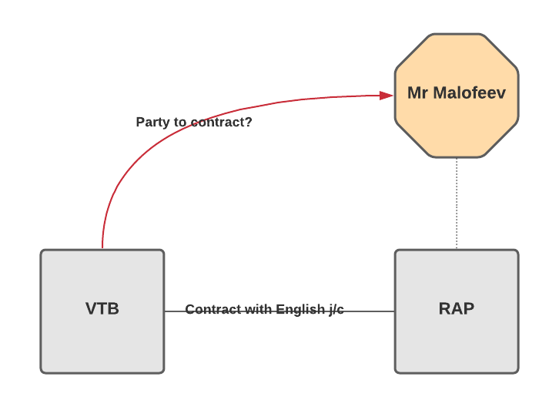
English law – piercing the corporate veil (2)
VTB v Nutritek [2013] 1 All ER 1296
Two problems:
Not a situation where the controller is evading an existing liability. Not an abuse to cause a liability to be incurred by the company in the first place.
Doctrine cannot be used to hold the controller liable as if he is a contracting party, when he is not party to the contract.

Slide 12
Discussion points
Choice of law
New York company. Arguably, apply the law of the place of incorporation: see VTB at para 131.
Akhmedova v Akhmedov [2018] EWFC 23 (Fam) at para 61: lex fori.
Tribunal not bound by domestic choice of law rules.
2. Party autonomy – parties’ choice not to make the controller a party to the contract.
3. Legal certainty v discretion to achieve justice in the particular case.

Slide 13
Arbitration mini series
Friday 30 April at 12.30pm, Session 1:
Jurisdiction: Section 9 challenges and the Tribunal’s jurisdiction over third parties
chaired by Fionn Pilbrow QC
Jasbir Dhillon QC
Fred Hobson
Ben Woolgar

