Slide 1
Annual Commercial Conference
Thursday 5th October 2023
“We need to talk about Class Actions”
Chaired by Tony Singla KC

Slide 2
Annual Commercial Conference
Thursday 5th October 2023
“We need to talk about Class Actions”
Securities Litigation
Kyle Lawson
Jacob Rabinowitz

Slide 3
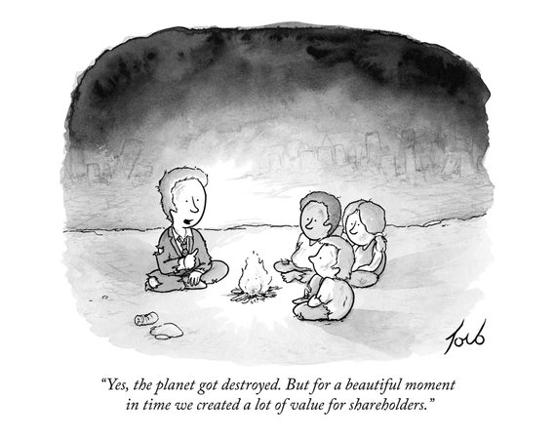
SECURITIES LITIGATION

Slide 4
RECENT CASES
RBS Rights Issue Litigation
Tesco Litigation
Lloyds/HBOS Litigation
RSA
Serco
G4S
Autonomy
Barclays LX
Glencore

Slide 5
KEY ISSUES FOR FUTURE CLAIMS
HOW should claims be managed?
Representative actions under CPR 19.8 or group actions?
WHO can bring claims?
Original subscribers or aftermarket purchasers?
WHAT are the requirements for liability?
Do claimants need to prove reliance on misstatements / omissions?
HOW MUCH do claimants stand to recover?
In principle: what losses are recoverable under s.90 and s.90A; and can ‘holding’ claimants under s.90A establish any loss?
In practice, how is quantum to be assessed?

Slide 6
Annual Commercial Conference
Thursday 5th October 2023
“We need to talk about Class Actions”
Data and Tech Claims
Victoria Wakefield KC
Sarah O’Keeffe

Slide 7
Annual Commercial Conference
Thursday 5th October 2023
“We need to talk about Class Actions”
ESG Litigation
Tim Johnston
Jessie Ingle

Slide 8
Annual Commercial Conference
Thursday 5th October 2023
“We need to talk about Class Actions”
Chaired by Tony Singla KC
TEA DOWNSTAIRS

Slide 9
Annual Commercial Conference
Thursday 5th October 2023
“We need to talk about Class Actions”
Group Litigation Orders
Simon Salzedo KC
Jo Box

Slide 10
Annual Commercial Conference
Thursday 5th October 2023
“We need to talk about Class Actions”
Representative Actions
Gerard Rothschild
Jaamae Hafeez-Baig

Slide 11
“Only one condition must be satisfied before a representative claim may be begun or allowed to continue:
that is, that the representative has ‘the same interest’ in the claim as the person(s) represented.”
Lloyd v. Google [2022] AC 1217 at [69] per Lord Leggatt

Slide 12
Rules of the Supreme Court 1883
O. XVI, r. 9
“Where there are numerous persons having the same interest in one cause or matter, one or more of such persons may sue or be sued, or may be authorised by the Court or a judge to defend in such cause or matter, on behalf of or for the benefit of all persons so interested.”
Civil Procedure Rules
r. 19.8(1)
“Where more than one person has the same interest in a claim –
(a) the claim may be begun; or
(b) the court may order that the claim be continued,
by or against one or more of the persons who have the same interest as representatives of any other persons who have that interest.”

Slide 13
Lloyd v. Google LLC [2021] UKSC 50; [2022] AC 1217
Commission Recovery Ltd. v. Marks & Clerk LLP [2023] EWHC 398 (Comm)
Prismall v. Google UK Ltd. & DeepMind Technologies Ltd. [2023] EWHC 1169 (KB)

Slide 14
Annual Commercial Conference
Thursday 5th October 2023
“We need to talk about Class Actions”
Funding and Costs
Simon Birt KC
Charlotte Thomas

Slide 15
Annual Commercial Conference
Thursday 5th October 2023
“We need to talk about Class Actions”
Jurisdiction
Charles Hollander KC
Zahra Al-Rikabi

Slide 16
Annual Commercial Conference
Thursday 5th October 2023
“We need to talk about Class Actions”
Chaired by Tony Singla KC
DRINKS DOWNSTAIRS

